Slide 1

COMPUTATION OF STABLE DELAY MARGIN AND RELATIVE STABILITY REGION FOR NETWORKED MICROGIRD SYSTEM WITH COMMUNICATION DELAY
Presented by
N.Swarnalakshmi(16EE315)
Under the guidance of
Dr.K.Ramakrishnan, M.E.,Ph.D
Associate Professor
Department of EEE
1

Slide 2
OBJECTIVE
To synthesis a dynamic model for micro-grid system with Plug-in-Electrical-Vehicle (PEV) and communication delay.
To compute stable delay margin for a specified phase margin, gain margin and controller parameters.
To compute stability region in the controller parametric space for a specified phase margin, gain margin and network-induced time-delay.
To compute stability region in controller parameter space for a given relative stability specification.
To carryout extensive simulation based studies to validate the analytical studies.
2

Slide 3
Introduction
Micro-grid system is define as cluster of micro-sources, storage system and loads.
Load frequency control of micro-grid system involves communication channels for the information transfer. This introduces time delay in the networked closed loop micro-grid control system.
The time delay in feedback loop adversely affects the performance of the closed loop system causing instability.
If delay exceeds a critical value(stable delay margin), the overall system loses stability.
Upon losing the stability, the micro grid system trips from grid, this subsequently leads to catastrophic chain of black outs
3

Slide 4
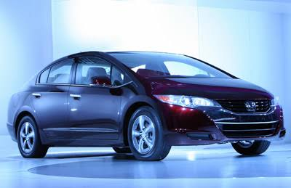

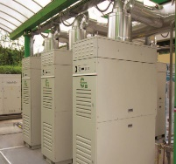
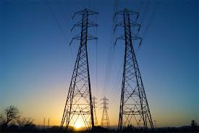
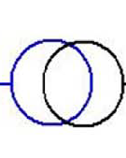
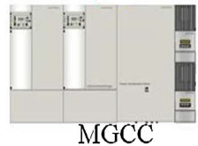
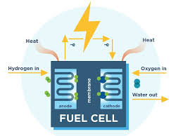
Micro-grid system model
PV panel
LV
Diesel generator
Main Grid
PEV
Fuel Cell
Fig 1. Micro-grid with plug-in-electrical vehicles
4

Slide 5
Micro-grid LFC system with PEV
Communication delay
PEVs Charging station
Generator
Central Controller
GPMT
Non dispatch able generator
PV generator
Load demand
Fig 2. Dynamic model of communication based micro-grid system
5

Slide 6
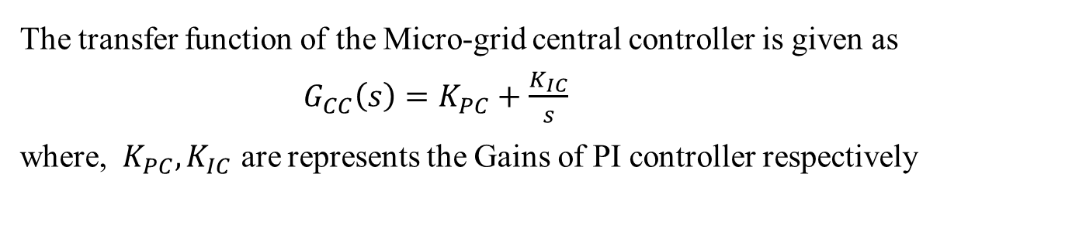
Micro-grid central controller (MGCC)
The main function of Micro-grid central controller are to obtain measurement and control information from local controllers, to monitor the system integrity and to decide and implement necessary control actions for regulating frequency and voltage.
The function of the controller is to compensate the variations in load and power generated by wind turbine and PV system. The micro-grid central controller acts as a secondary frequency control, which sets the real power reference.
The transfer function of the Micro-grid central controller is given as
${ G}_{CC}\left(s\right)=K_{PC}+\frac{K_{IC}}{s}$
where, ${ K}_{PC},K_{IC}$ are represents the Gains of PI controller respectively
6

Slide 7


PLUG-IN-ELECTRICAL VEHICLE (PEV)
Internet
Main Grid
PEV
Fig 3. PEV to the grid connection
7

Slide 8


Contd.,
As the normal vehicles, the PEVs are provided with GPS and have wireless internet connectivity to communicate with the MGCC.
The PEVs have a significant impact on the stability of the micro grid dominated by renewable energy, where the PEVs incorporated with controller can mitigate the fluctuations resulting from the renewable energy sources
The MGCC implements a PI controller and sends the LFC signal to the PEVs charge station through a wireless communication network.
If there is a mismatch between the generation and the demand, caused by either increase/decrease in the load or the generation the frequency will deviate depending on the inertia M and the load damping constant, D.
First order approximation of PEV =
$$\frac{K_{PEV}}{1+sT_{e}}$$
where $K_{PEV}$ =22.1,$T_{e}$=1
8

Slide 9
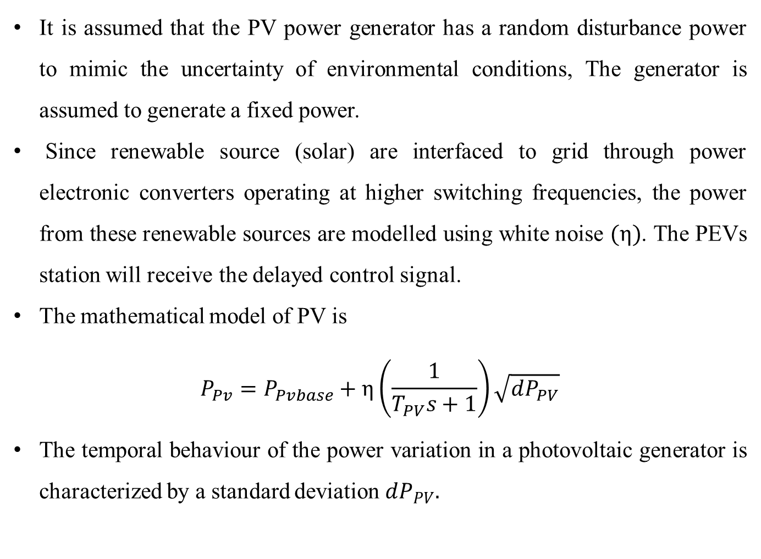
PV GENERATOR AND DIESEAL GENERATOR
It is assumed that the PV power generator has a random disturbance power to mimic the uncertainty of environmental conditions, The generator is assumed to generate a fixed power.
Since renewable source (solar) are interfaced to grid through power electronic converters operating at higher switching frequencies, the power from these renewable sources are modelled using white noise $(η)$.The PEVs station will receive the delayed control signal.
The mathematical model of PV is
$$P_{Pv}=P_{Pvbase}+η\left(\frac{1}{T_{PV}s+1}\right)\sqrt{dP_{PV}}$$
The temporal behaviour of the power variation in a photovoltaic generator is characterized by a standard deviation $dP_{PV}.$
9

Slide 10

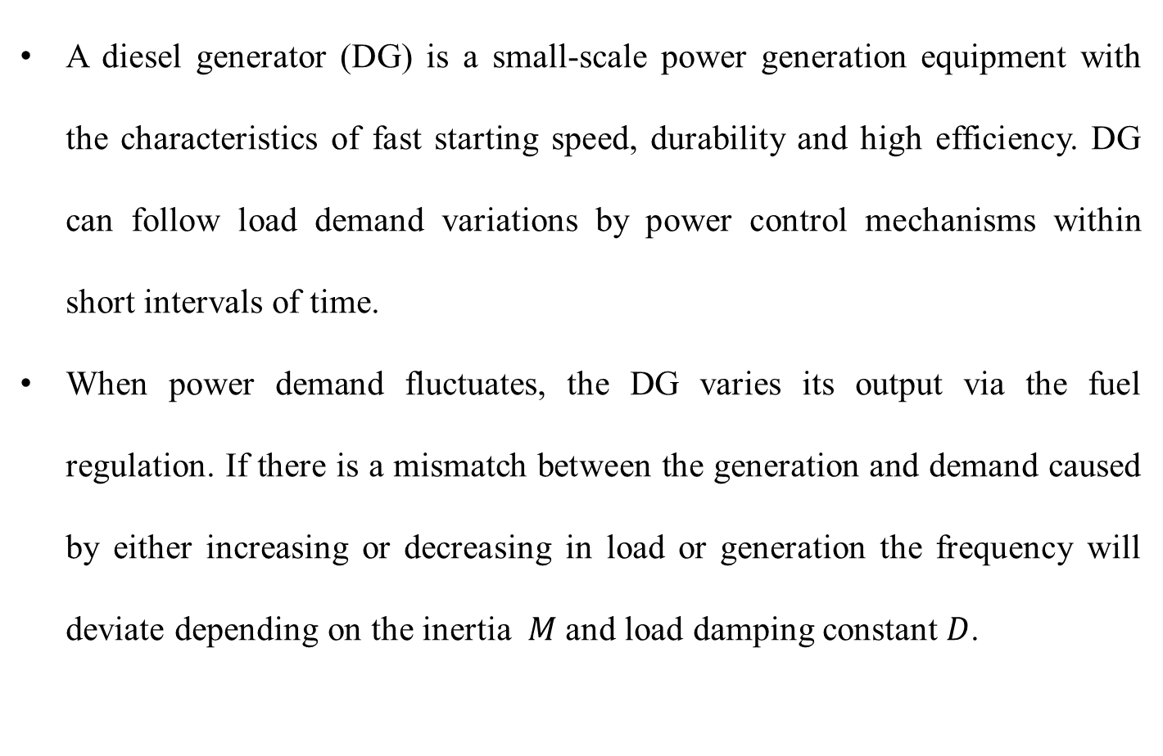
A diesel generator (DG) is a small-scale power generation equipment with the characteristics of fast starting speed, durability and high efficiency. DG can follow load demand variations by power control mechanisms within short intervals of time.
When power demand fluctuates, the DG varies its output via the fuel regulation. If there is a mismatch between the generation and demand caused by either increasing or decreasing in load or generation the frequency will deviate depending on the inertia$M$ and load damping constant$D$.
$$\frac{\left.∆f(s\right)}{\left.∆P_{s}(s\right)}=\frac{1}{Ms+D}$$
10

Slide 11
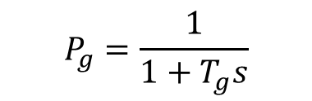
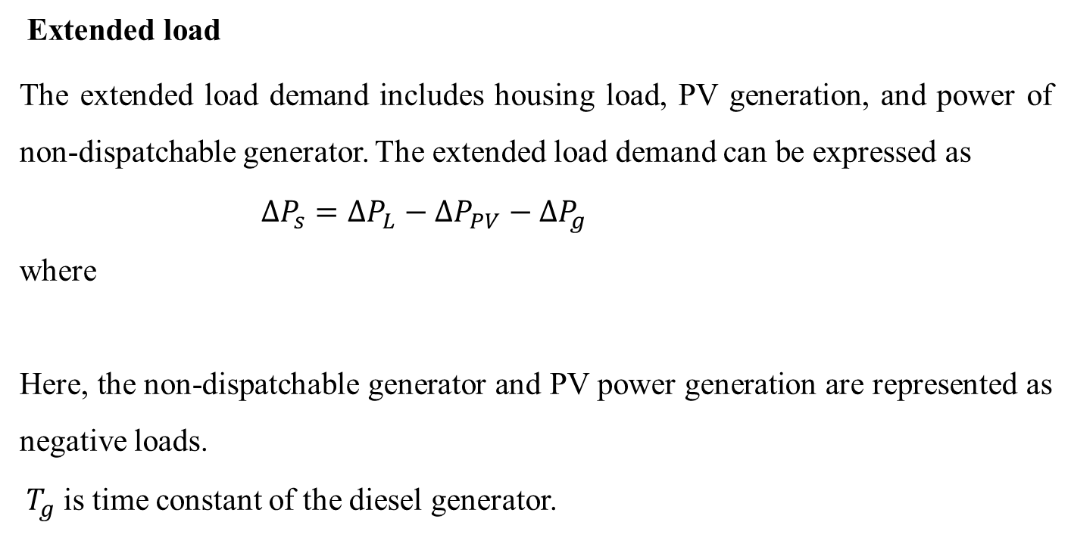
Contd.,
Extended load
The extended load demand includes housing load, PV generation, and power of non-dispatchable generator. The extended load demand can be expressed as
$∆P_{s}=∆P_{L}−∆P_{PV}−∆P_{g}$
where
Here, the non-dispatchable generator and PV power generation are represented as negative loads.
${ T}_{g}$is time constant of the diesel generator.
$$P_{g}=\frac{1}{1+T_{g}s}$$
11

Slide 12
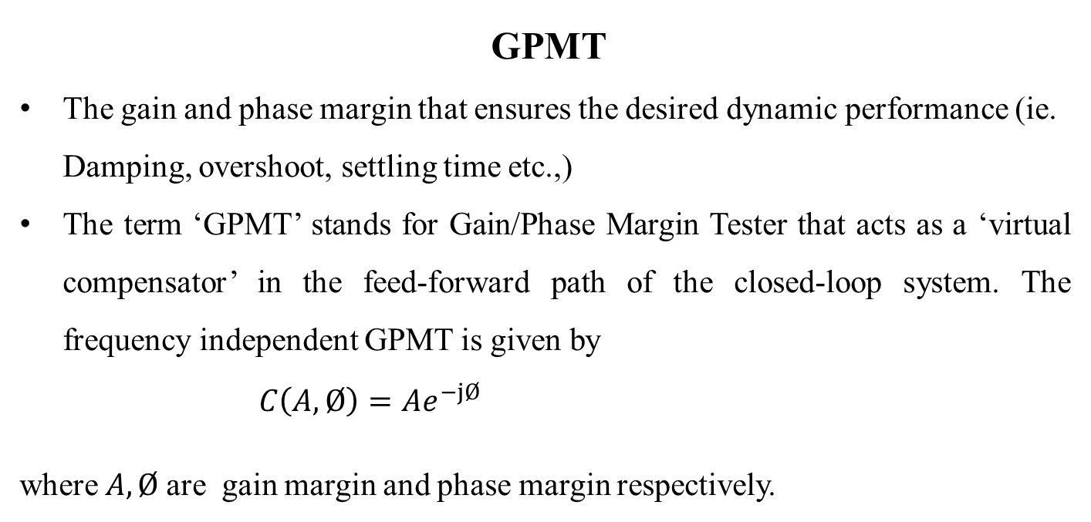
GPMT
The gain and phase margin that ensures the desired dynamic performance (ie. Damping, overshoot, settling time etc.,)
The term ‘GPMT’ stands for Gain/Phase Margin Tester that acts as a ‘virtual compensator’ in the feed-forward path of the closed-loop system. The frequency independent GPMT is given by
${C\left(A,Ø\right)=Ae}^{−jØ}$
where$A,Ø$are gain margin and phase margin respectively.
12

Slide 13
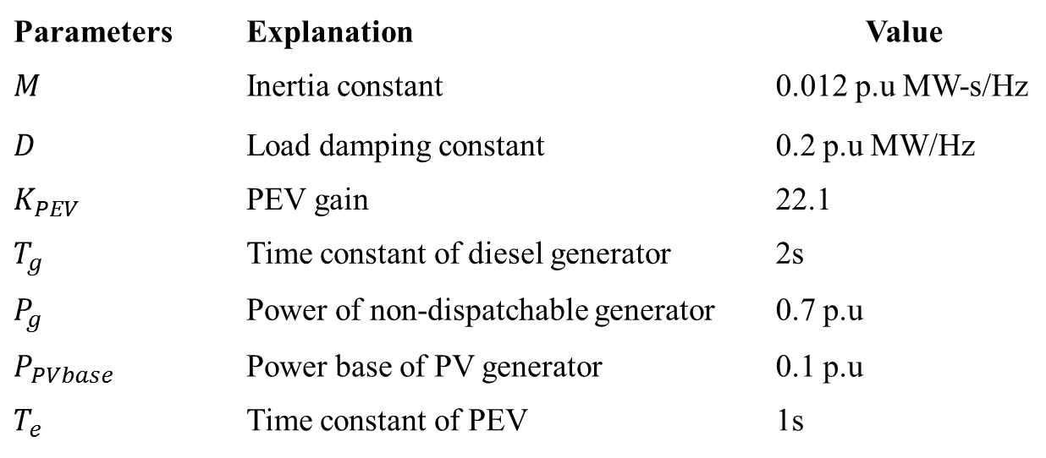
Parameters of Micro-grid system with PEV
Parameters | Explanation | Value
$$M$$ | Inertia constant | 0.012 p.u MW-s/Hz
$$D$$ | Load damping constant | 0.2 p.u MW/Hz
$$K_{PEV}$$ | PEV gain | 22.1
$$T_{g}$$ | Time constant of diesel generator | 2s
$$P_{g}$$ | Power of non-dispatchable generator | 0.7 p.u
$$P_{PVbase}$$ | Power base of PV generator | 0.1 p.u
$$T_{e}$$ | Time constant of PEV | 1s
13

Slide 14

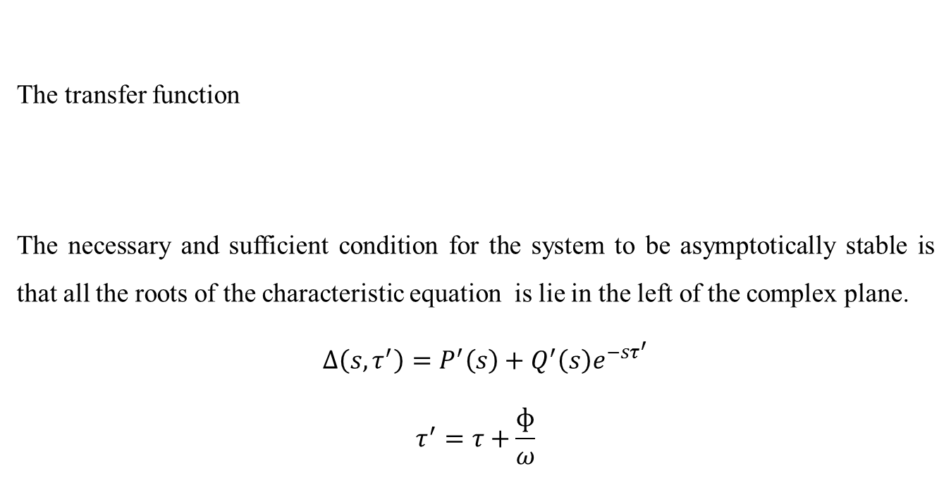
Closed loop transfer function
The transfer function
The necessary and sufficient condition for the system to be asymptotically stable is that all the roots of the characteristic equation is lie in the left of the complex plane.
$∆\left(s,τ^{′}\right)=P^{′}\left(s\right)+Q^{′}\left(s\right)e^{−sτ^{′}}$
$$τ^{′}=τ+\frac{ɸ}{ω}$$
$$\frac{∆f}{∆f_{ref}}=\frac{K_{PEV}\left(sK_{PC}+K_{IC}\right)Ae^{−sτ^{′}}}{P\left(s\right)+Q\left(s\right)e^{−sτ^{′}}}$$
It is obvious that the roots of above equation are a function of the time delay. For the system to be asymptotically stable, all the roots of the characteristic equation must lie in the left half of the complex plane.
14

Slide 15
THANK YOU

